Slide 1

Unnat Bharat Abhiyan 2.0
A Flagship program of Ministry of Human Resource Development
Workshop on
Smart GEO Survey & Smart GEO PRA for UBA 2.0 :
A Model of Gram Swaraj
January 25 & 26, 2019 : Bharatiyar University, Coimbatore.
P M V Subbarao
Professor
Mechanical Engineering Department & CRDT
Chairman, Committee of SEG Coordinators

Slide 2
The Concept of Gram Swaraj in UBA 2.0 : The Concept
P M V Subbarao
Professor
Mechanical Engineering Department & CRDT
Chairman, Committee of SEG Coordinators
Learning is Only for Service …..

Slide 3


The way I understood Him
वैष्णव जन तो तेने कहिये जे पीड़ परायी जाणे रे
The Essence of True Knowledge is to Help the Needy…...

Slide 4

Realization of A Research Journey

Slide 5
Inspiring Words : Albert Einstein
When asked what he wished to become, as a young man, Nobel Laureate Albert Einstein said,
"I want to become a useful person, not a successful person."
Asked what he meant by it, the eminent physicist replied,
"A successful person is one who takes from society more than what he gives it.
A useful person is one who gives the society more than what he takes from it."

Slide 6

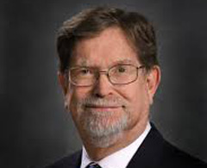
Address by Chief Guest @ 2014 Convocation, IIT Delhi
Prof. George F. Smoot III
2006 Nobel Laureate in Physics
University of California Berkeley
“He pointed out the futility of a degree when so many great minds are not applying their knowledge for the country”

Slide 7
Gram Swaraj :
A pivotal concept in Mahatma Gandhi's thinking
The fundamental concept of Gram Swaraj is that every village should be its own republic,
"independent of its neighbors for its own vital wants and yet interdependent for many others in which dependence is necessary," according to Gandhi, writing in 1942.
Each village should be basically self-reliant, making provision for all necessities of life - food, clothing, clean water, sanitation, housing, education and so on ….

Slide 8

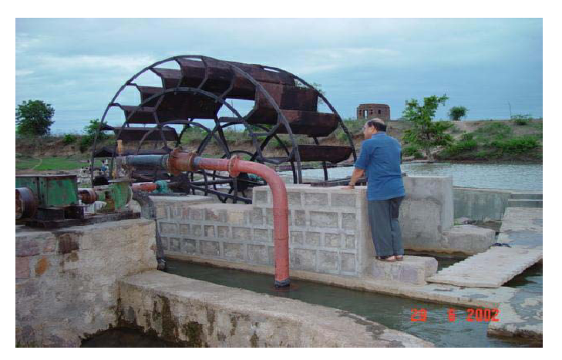
Working in/for Rural Areas
Shri Mangal Singh
Water Wheel on River Sajnam, Bhailoni Lod Village
Lalitpur Dist.

Slide 10
Unnat Bharat Abhiyan
A flagship programme of Ministry of Human Resource Development (MHRD), Govt. of India
UBA is inspired by the vision of transformational change in rural development processes by leveraging knowledge institutions to help build the architecture of an Inclusive India
Vision
To involve the higher educational institutions (technical / non-technical / public / private) of the country in the process of indigenous development of self-sufficient and sustainable village clusters.

Slide 11
Mission
Coordination among educational institutions, implementation agencies and the grass root level stakeholders
Effective participation in the holistic development of rural clusters using
  Eco-friendly sustainable technologies
  Harnessing Local resources
  Creating employment opportunities
  Harnessing multifarious government schemes
  Customisation of existing technologies
  Use of local knowledge
Reorienting the academic curriculum and research programs in higher educational institutions

Slide 12
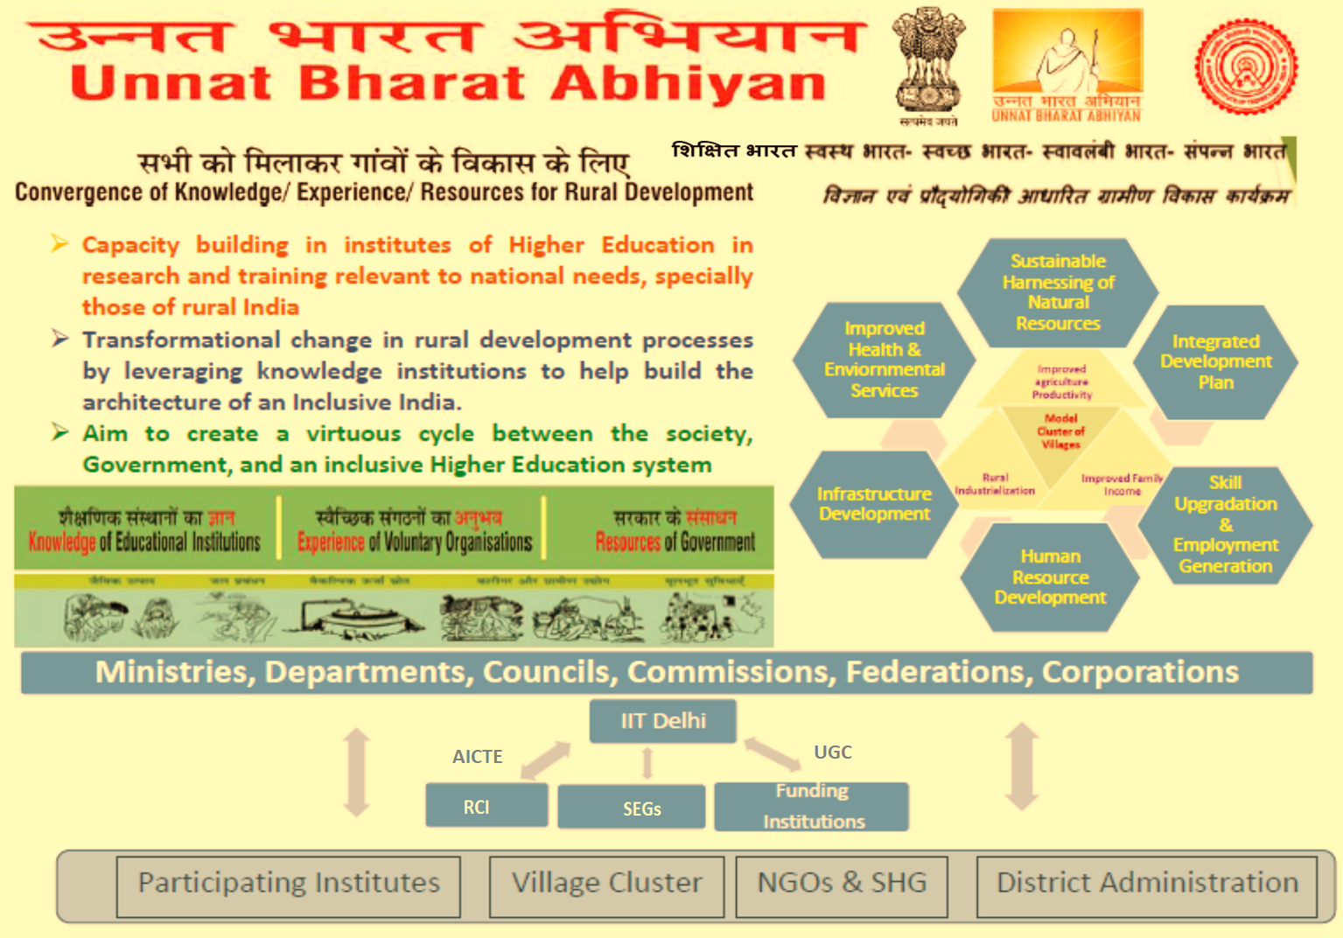

Slide 13
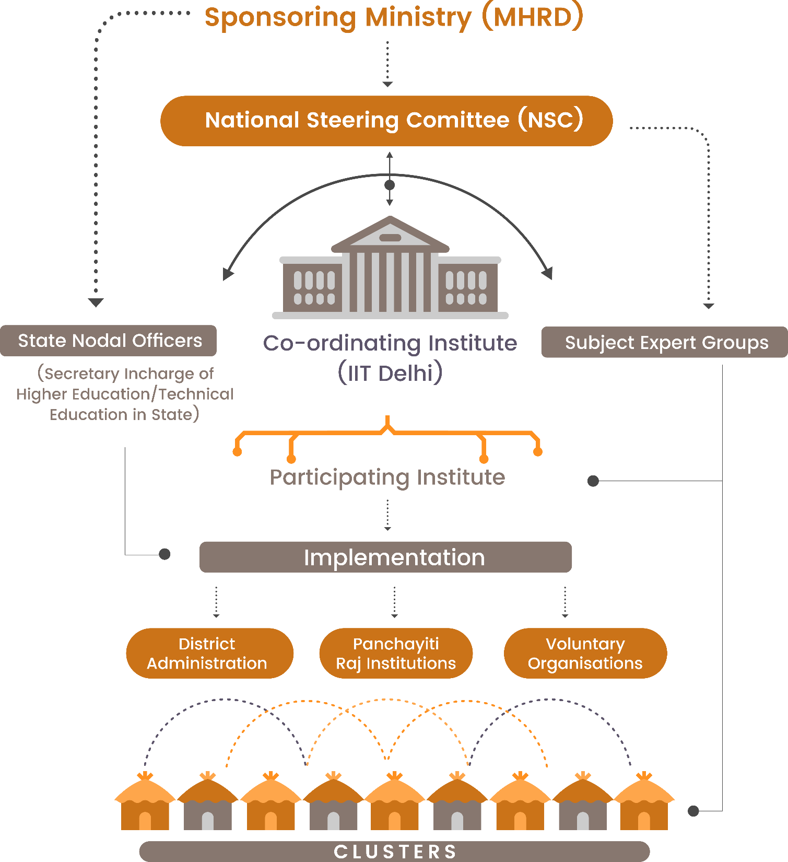
Organizational Structure of UBA

Slide 14
Unnat Bharat Abhiyan 1.0
Conceptualized by a group of dedicated faculty members of IIT Delhi
Accepted by MHRD and launched by The President of India on 11th November, 2014
Total 143 PIs (98 Technical and 45 Non-Technical), each adopted 5 villages for the technical intervention
Coverage
  715 Villages
  128 Districts
  29 States
  15 Mentoring Institutions identified

Slide 15
Unnat Bharat Abhiyan 2.0
UBA- 2.0 launched on April 25th, 2018
Selection through challenge mode
  Both Technical and Non-Technical Institutes
    History of engagement with rural communities
    Adequate faculty
    Commitment to the programme objectives
PIS will use their own resources/generate funds for the field visits and any other expenses not specifically funded under the scheme.
Small grants will be sanctioned, for well defined technological development or customization, as recommended by Subject Expert Groups
Tiny grants will be made available for Carrying out field studies, study the implementation of Govt. schemes, and facilitate their better implementation so that they meet their objectives in best way

Slide 16
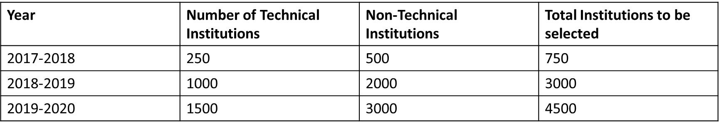
Unnat Bharat Abhiyan 2.0
Approve Growth of UBS Networking
Following evolution of UBA networking is proposed For first three years.
Present Coverage
Total PIs | Total States Covered | Total Districts Covered | Total Villages Covered
688 Tech (428), Non-Tech (260) | 33 | 370 | 3555
1144 Tech(601), Non-Tech(543) | 33 | 183(New district covered) 370+183=553(Total district covered) | 5720

Slide 17
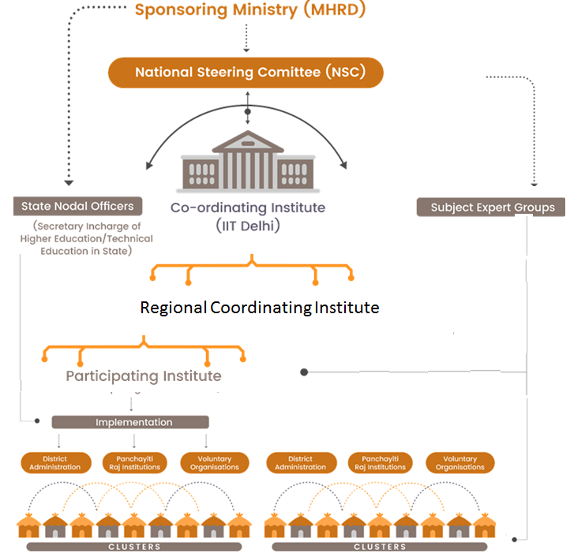
Organizational Structure of UBA 2.0
Subject Expert Groups

Slide 18
Subject Expert Group (SEG)
For providing operational expertise sought by the Higher Education Institutes (HEIs) engaged in the village exercise.
To provide requisite training, orientation, and help in actual implementation process
To develop course material to reorient the training of students studying professional institutions.
They evaluate and approve the technical solutions proposed by the HEIs and monitor the customisation process.
  Rs. 1.0 lakh, Assistance for selection of technology to PIs
  Rs 50,000/- Assistance for customization of solutions to PIs

Slide 19
Technology Development Projects Sanctioned by SEG
 | Recommended |  | Received
Energy/Equipment | 12 |  | 31
School Education | 3 |  | 6
Agriculture | 8 |  | 12
Health | 4 |  | 8
Water/ Sanitation | 2 |  | 13
Waste, Entrepreneurship | 2 |  | 2
Skill Development/capacity building | 0 |  | 23
Non-UBA Focus | 0 |  | 10
Total | 31 |  | 105

Slide 20
Technology Customization Projects Sanctioned by SEG
 | Recommended |  | Received
Energy/Equipment | 3 |  | 5
School Education | 2 |  | 3
Agriculture | 0 |  | 6
Health | 0 |  | 1
Water/ Sanitation | 2 |  | 10
Waste, Entrepreneurship | 1 |  | 1
Skill Development, capacity building | 1 |  | 12
Non-UBA Focus | 0 |  | 1
Total | 9 |  | 39

Slide 21
UBA- New Initiatives…. 1
A Rural Internship Program
Rural and Swadeshi Startup Meet
Incentivizing PIs
  Additional fund/rewards to those who will bring more funds/ projects
Rewards/ Award to those PIs which shows excellent work – proposed in new SFC of UBA in MHRD
Gram Sabhas on 15th August 2018 were organized in which 244 PIs(Participating Institutes) organized gramsabha in 732 villages.
  Approval of Gram Sabha for taking up 2-3 issues/ problems by PIs to provide solutions/interventions was obtained

Slide 22
UBA- New Initiatives…. 2
Selection of Institutions for 2018-19 in challenge mode 1689 PIs
  545 new PIs have been selected in February 2018
  1144 new PIs have been selected in October 2018
Regional Coordinating Institutes to announced after approval of revised SFC

Slide 23
UBA- New Initiatives…. 3
Convergence
  Ministry of Ayush
  Department of Drinking Water & Sanitation
  MoRD
  ICAR
    New Scheme ‘Pandit Deen Dayal Upadhyay Unnat Krishi Shiksha Yojna’ (PDDUUKSY)
  Tripartite Agreement for UBA
    MHRD, MoRD and MoPanchayatiraj on the Unnat Bharat Abhiyan programme
  DISHA
  AICTE
    Made UBA part of the accreditation process for its Institutions
  UGC

Slide 24
Aim of This Workshop : To Help in Planning of Activity
Frame Work For Preparation of Plan of Action
Participatory Rural Appraisal (PRA) Tools And Techniques And Situation Analysis
Funding and Convergence Possibilities- Different central and state Govt Schemes and programs and CSR Support that can be Leveraged for UBA

Slide 25
Aim of This Workshop : Technical Support
Role of Subject Expert Groups (SEGs): Technical Consulting and Implementation Mechanisms
Participation in School Education thru Digital Learning tools (Eckovation)

Slide 26
AoW: And To Discuss Your Experiences So Far
Problems Identified and Solutions Proposed in villages

Slide 27
Thank You

